Slide 1

NODEMCU SENSORS/ACTUATORS INTERFACE
LECTURE 5-6

Slide 2
NodeMCU Installation ON ARDUINO IDE
Arduino allows installation of third-party platform packages using Boards Manager. We have packages available for Windows, Mac OS, and Linux (32 and 64 bit).

Slide 3
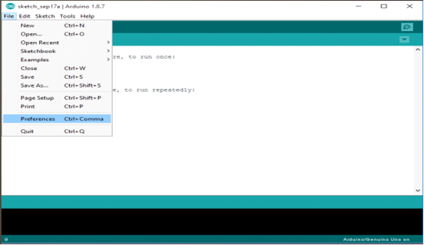
NodeMCU Installation ON ARDUINO IDE
Start Arduino and open Preferences window.

Slide 4
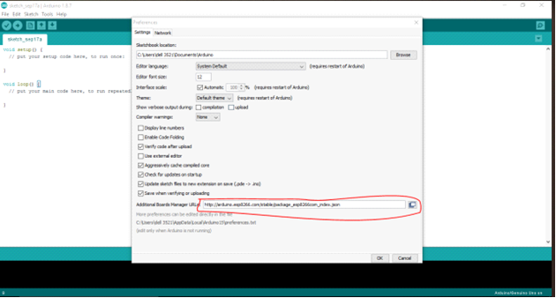
NodeMCU Installation ON ARDUINO IDE
Write "http://arduino.esp8266.com/stable/package_esp8266com_index.json" into Additional Board Manager URLs field.

Slide 5
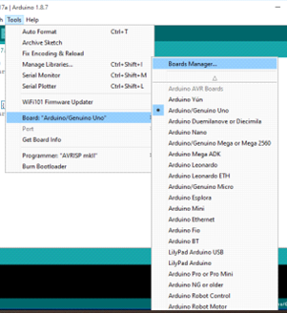
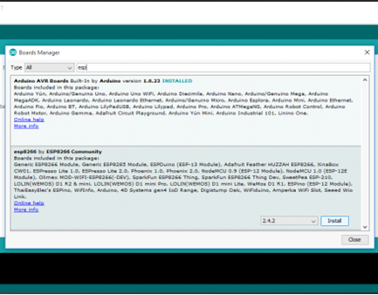
NodeMCU Installation ON ARDUINO IDE
Open Boards Manager from Tools > Board menu and install esp8266 platform.

Slide 6
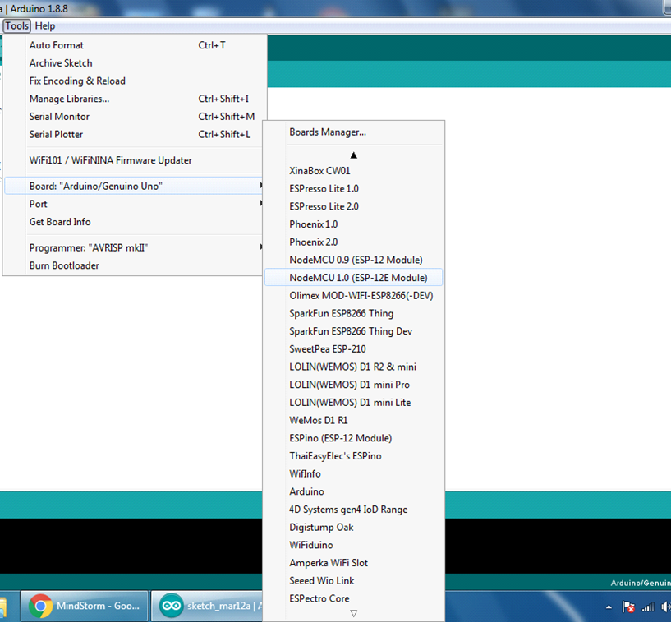
NodeMCU Installation ON ARDUINO IDE
Select NodeMCU 1.0 (ESP-12E Module) board with the COM Port from Tools > Board menu after installation.

Slide 7
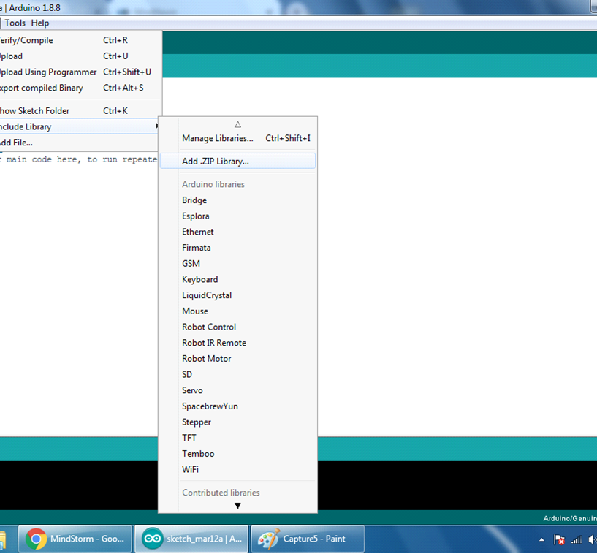
ADD LIBRARIES INTO ARDUINO IDE
Go to Sketch>Include Library>Add .zip Library

Slide 8
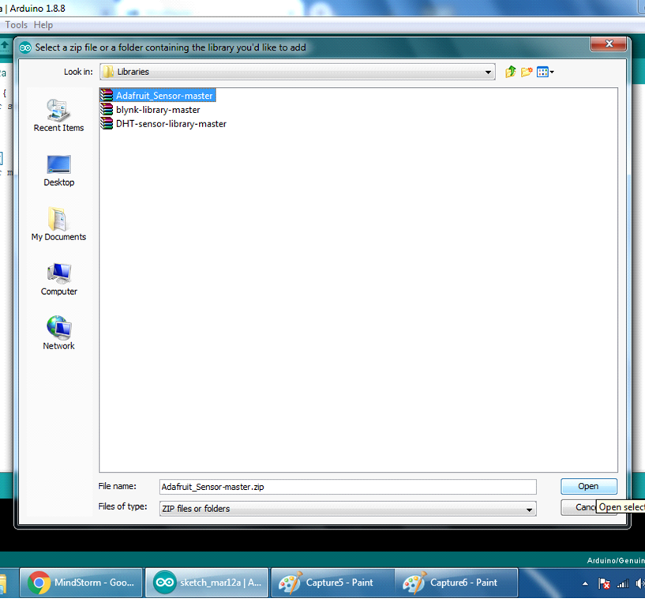
ADD LIBRARIES INTO ARDUINO IDE
Add .zip llibraries as required from the folder containing downloaded .zip libraries.

Slide 9
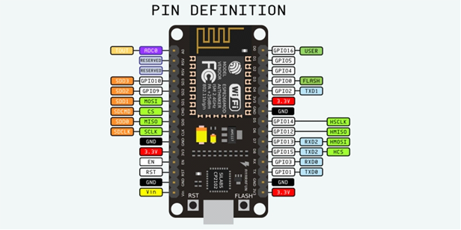
NODEMCU PINOUT

Slide 10
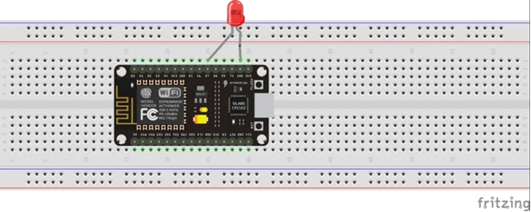
LED Blinking with NodeMCU

Slide 11
LED Blinking with NodeMCU
Components Needed:
NodeMCU
LED
Resistor
MicroUSB Cable
Breadboard/Jumper Wires.
First, connect the NodeMCU to the PC, then in Arduino select the port in which the NodeMCU is connected using Tools>Port, if the port is not automatically selected or is not showing in Adruino then go to Device Manager and see the Serial Ports.
Connections:
Anode pin of the LED to the pin D7 of NodeMCU.
Cathode pin of the LED to the any GND pin of NodeMCU.
(It is recommended to do the connections after code uploading)

Slide 12
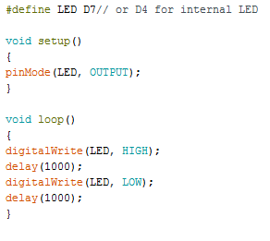
LED Blinking with NodeMCU
Upload the following code into the NodeMCU using Arduino IDE:

Slide 13
LED Blinking with NodeMCU
Code Explanation:
Firstly, using the statement <#define LED D7>, the pin D7 of the NodeMCU is defined as the LED pin (on which the LED will be connected).
Afterwards, in the <void setup()> function the mode for the LED pin is set to output because the LED works as an output/indicator component.
Lastly, in the <void loop()> function, the LED is set using <digitalWrite> to HIGH and LOW at one second interval using <delay(1000)> where 1000 means 1000 milliseconds or 1 second.
Result:
After uploading and connections are done we can check the result on hardware, the LED would be blinking with one second interval.

Slide 14
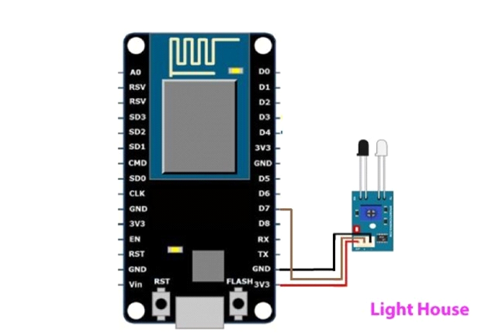
IR SENSOR WITH NODEMCU

Slide 15
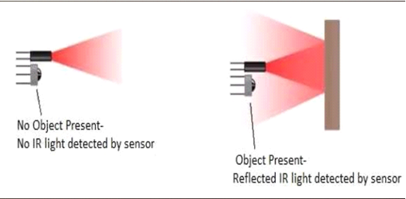
IR SENSOR WITH NODEMCU
Introduction:
An infrared sensor is an electronic instrument which is used to sense certain characteristics of its surroundings by either emitting and/or detecting infrared radiation. Usually in the infrared spectrum, all the objects radiate some form of thermal radiations. These types of radiations are invisible to our eyes, but can be detected by an infrared sensor.

Slide 16
IR SENSOR WITH NODEMCU
Components Needed:
NodeMCU
IR Sensor
MicroUSB Cable
Breadboard/Jumper Wires
Connections:
VCC Pin of IR Module is connected to any 3V pin of the NodeMCU.
GND Pin of IR Module is connected to any GND pin of the NodeMCU.
OUTPUT Pin of IR Module is connected to D7 pin of the NodeMCU.
(It is recommended to do the connections after code uploading)

Slide 17
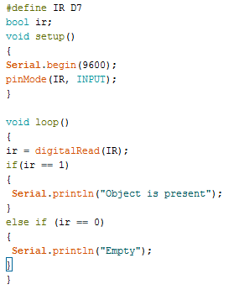
IR SENSOR WITH NODEMCU
Upload the following code into the NodeMCU using Arduino IDE

Slide 18
IR SENSOR WITH NODEMCU
Code Explanation:
Using the <#define IR D7> statement, the pin D7 of the NodeMCU was defined as the IR pin where the output pin of the IR module would be connected. After that variable "ir" is defined with the "bool" data type (since it will be used later in the code for reading the output of the IR module which can be either HIGH "1" or LOW "0").
Then in the <void setup()> function, the serial communication between the PC and NodeMCU is initiated with a baud rate of 9600 bit per second using <Serial.begin(9600)>, and the mode for the IR pin is set to INPUT using <pinMode> statement because the IR pin would take the output of the IR module as input to the NodeMCU.
Finally in the <void loop()> function, IR pin is digitally read and its value is stored in the "ir" variable, if its value is equal (==) to 1 [i.e an object is in front of the IR module's detection range] then "Object is Present" is printed on the Arduino serial monitor, if it is 0, then "Empty" is printed on the Arduino Serial monitor.
Result:
After uploading the code and making the connections, you can see how IR Sensor detects objects in front of it.

Slide 19
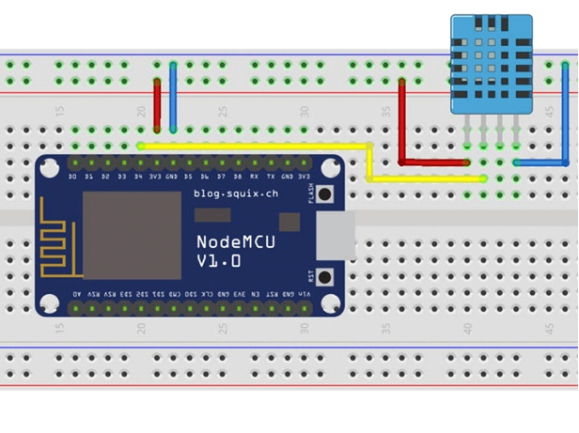
DHT11 SENSOR WITH NODEMCU

Slide 20
DHT11 SENSOR WITH NODEMCU
Introduction:
The DHT11 measures temperature with a surface mounted NTC (Negative Temperature Coefficient) Thermistor built into the unit which changes its resistance with the changing temperature, that change in temperature is converted into change in voltage in an analog manner and is transmitted. The DHT11 detects humidity(measure of water vapor) by measuring the electrical resistance between two electrodes. The humidity sensing component is a moisture holding substrate with electrodes applied to the surface. When water vapor is absorbed by the substrate, ions are released by the substrate which increases the conductivity between the electrodes. The change in resistance between the two electrodes is proportional to the relative humidity.

Slide 21
DHT11 SENSOR WITH NODEMCU
Components Needed:
NodeMCU
DHT11 Temperature and Humidity Sensor.
MicroUSB Cable
Breadboard/Jumper Wires
Connections:
The first pin from the left (VCC) of the DHT11 is connected to any 3V pin of the NodeMCU.
The second pin from the left (OUTPUT) of the DHT11 is connected to D4 pin of the NodeMCU.
The third pin is left unconnected.
The fourth pin (GND) of the DHT11 is connected to any GND pin of the NodeMCU.
(It is recommended to do the connections after code uploading)

Slide 22
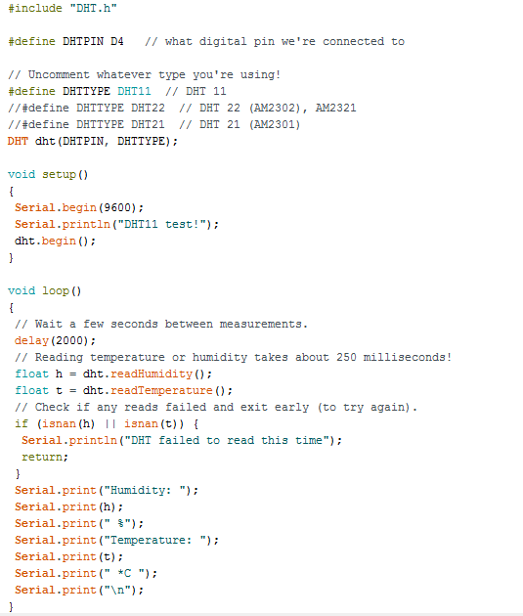
DHT11 SENSOR WITH NODEMCU
Upload the following code into the NodeMCU using Arduino IDE:

Slide 23
DHT11 SENSOR WITH NODEMCU
Code Explanation:
Firstly the DHT.h header file is included in the program. Then the pin D1 of the NodeMCU is defined as DHTPIN where the output pin of the DHT sensor/module will be connected to the NodeMCU. Then the type of the DHT sensor used is defined (DHT11 in this tutorial).
Then the function DHT dht (DHTPIN,DHTTYPE); is used for the internal settings of dht11, namely the pin to bit masking and the time interval in microseconds at which DHT senses the temperature and humidity.
In the void setup() function the serial communication between the PC and the NodeMCU is initialized at a baudrate of 9600 bit per second. Moreover "DHT11 Test" is printed on the Arduino Serial Monitor. The dht.begin(); initiates the communication between the DHT11 sensor and the NodeMCU.
In the void loop() function, firstly a time delay of 2 seconds is added to wait in between DHT11 measurements. Then the temperature and humidity is sensed by readTemperature and readHumidity and saved in the variables "t" and "h" respectively.
Then, using the if (isnan(h) || isnan(t)), if the value of "h" or "t" is NaN (Not a Number) which means that if the DHT was not able to sense a value, then "DHT failed to read this time" is printed on the Arduino Serial Monitor.
And finally, the values of temperature, and humidity with their units is printed on the Serial Monitor.
Result: After the code is uploaded and the connections are mae, the Arduino Serial Monitor would be showing the Temperature and Humidity measurements after a set interval.

Slide 24
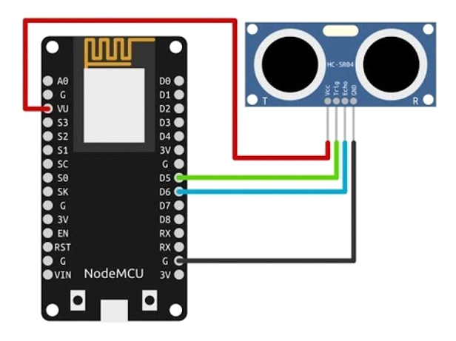
UlTRASONIC SENSOR WITH NODEMCU

Slide 25
ULTRASONIC SENSOR WITH NODEMCU
Introduction:
In this tutorial we will learn about HC-SR04 widely known as Ultrasonic Sensor, how it works and how to interface with the NodeMCU. And also how to measure the distance using HC-SR04.
An Ultrasonic sensor is a device that can measure the distance of an object by using sound waves. It measures distance by sending out a sound wave at a specific frequency and waits for that sound wave to bounce back. By recording the time taken between the sound wave being generated and the sound wave bouncing back, it is possible to calculate the distance between the sensor and the object.

Slide 26
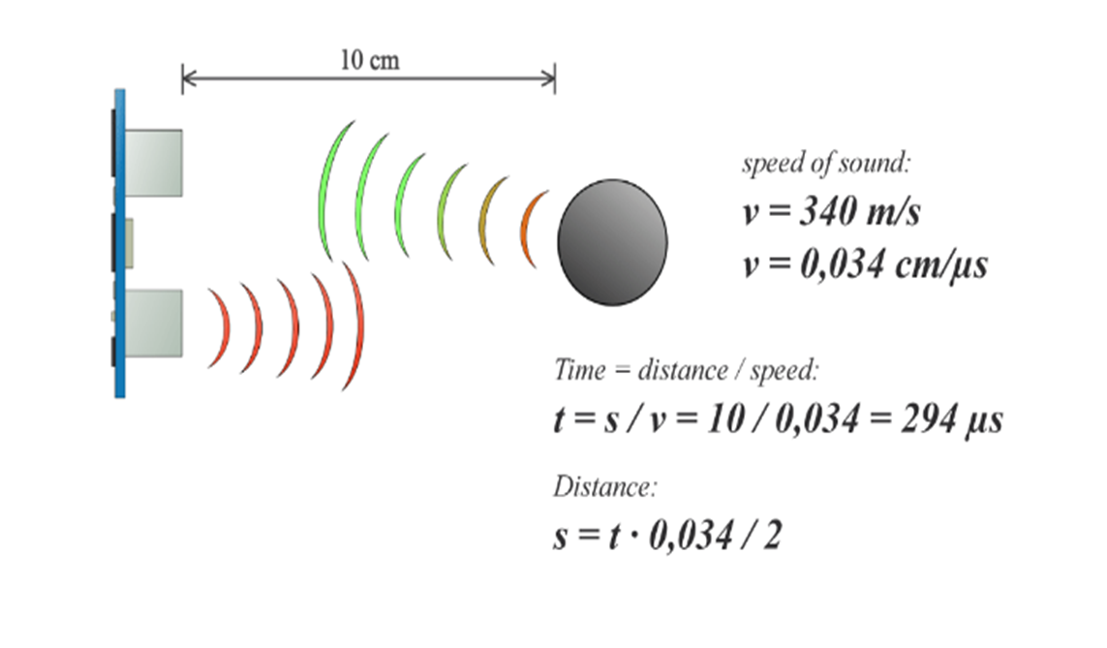
ULTRASONIC SENSOR WITH NODEMCU

Slide 27
ULTRASONIC SENSOR WITH NODEMCU
Components Needed:
NodeMCU
HC-SR04 Ultrasonic Sensor
MicroUSB Cable
Breadboard/Jumper Wires
Connections:
VCC pin of the Ultrasonic sensor is connected to the VU pin of the NodeMCU.
GND pin of the Ultrasonic sensor is connected to the GND pin of the NodeMCU.
TRIG pin of the Ultrasonic sensor is connected to the D5 pin of the NodeMCU.
ECHO pin of the Ultrasonic sensor is connected to the D6 pin of the NodeMCU. (It is recommended to do the connections after code uploading)

Slide 28
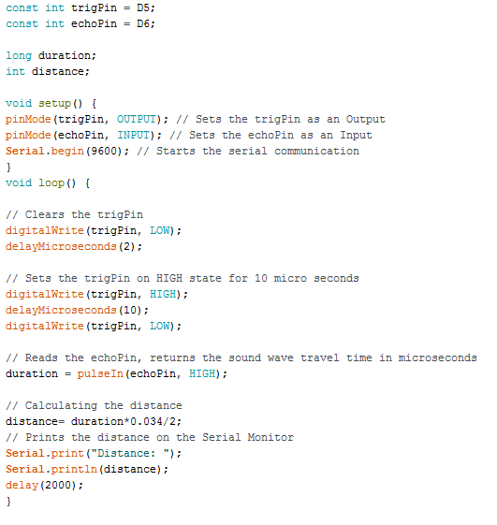
ULTRASONIC SENSOR WITH NODEMCU

Slide 29
ULTRASONIC SENSOR WITH NODEMCU
Code Explanation:
Firstly the D5 and D6 pin of the NodeMCU are defined as trigPin and echoPin respectively, as constants with integer data type.Then a variable "duration" is defined with a float data type because it will hold the value of the sound wave travel time (microseconds) which will have decimal points.
In the <void setup()> function the pin modes for trigPin and echoPin are set, moreover the serial communication between the PC and the NodeMCU is initialized at a baud rate of 9600 bits per second.
In the <void loop()> function, firstly the trigPin is cleared by setting it LOW and waiting for 2 milliseconds, and then it is set HIGH for 10 millisecond as to transmit a 10 ms sound wave trigger pulse, again setting it LOW afterwards.
The time taken by the pulse to hit an object and returning back is calculated by the pulseIn function which measures that after how long the echo Pin recieved a HIGH after the sound wave trigger pulse was transmitted, this time is saved in the duration variable.
Finally the distance is calculated by multiplying the duration with the velocity of sound (0.034 centimeters/microseconds) as to employ the formula s=vt, this distance is divided by two because it is calculated on the two-way time (pulse going to the object and returning back after hitting the object) and only one-way of it is sufficient.
Result: After the connections are made, the Arduino Serial Monitor would be showing the distance between the ultrasonic sensor and the object placed in front of it in centimeters.

Slide 30
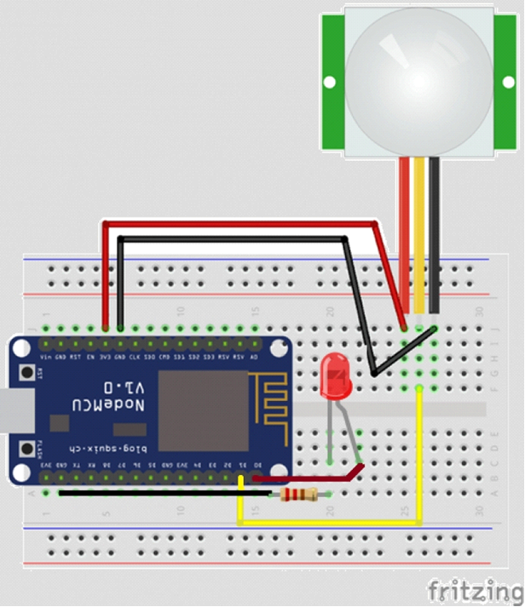
PIR SENSOR WITH NODEMCU

Slide 31
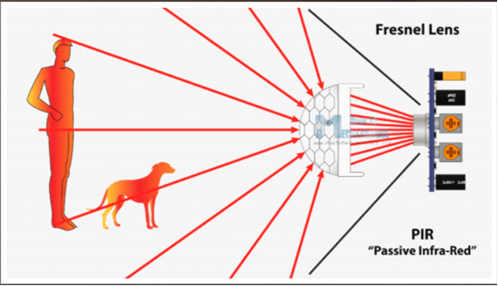
pIR SENSOR WITH NODEMCU
Introduction:
PIR (Passive Infrared) sensor detects the Infrared waves emitted by humans. The IR sensor itself is housed in a hermetically sealed metal can to improve noise/temperature/humidity immunity. There is a window made of IR-transmissive material that protects the sensing element. Behind the window are the two balanced sensors. This whole arrangement is covered with a Fresnel Lens because of which IR rays in a large area are converged in the IR sensor inside.

Slide 32
pIR SENSOR WITH NODEMCU
Components Needed:
NodeMCU
PIR Sensor
Resistor
Red LED
MicroUSB Cable
Breadboard/Jumper Wires
Connections:
Anode and Cathode pins of the LED are connected to D0 and GND pins of the NodeMCU respectively.
VCC and GND pins of the PIR Module are connected to VIN and GND pins of the NodeMCU respectively.
OUTPUT pin of the PIR Module is connected to pin D1 of the NodeMCU. (It is recommended to do the connections after code uploading)

Slide 33
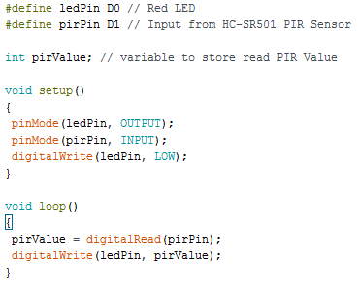
PIR SENSOR WITH NODEMCU
Upload the following code into the NodeMCU using Arduino IDE

Slide 34
pIR SENSOR WITH NODEMCU
Code Explanation:
Using <#define ledPin D0> the pin D0 of the NodeMCU is defined as the LedPin, similarly using <#define pirPin D1> the pin D1 of NodeMCU is defined as the "pirPin" where the output pin of the HC-SR501 PIR module is connected.
Then using <intpirValue> a variable "pirValue" with integer data type is defined which will save the value of output pin of PIR module.
In the <void setup()> function the pin modes for the LedPin and the pirPin as output and input respectively, moreover using <digitalWrite> command the LedPin is initially set to LOW.
Finally, in the <void loop() > function, the pirPin (D1) is digitally read for the output of the PIR sensor, and this output value (HIGH only if a living one is present in the detection range) is saved in the pirValue variable, then according to this pirValue (HIGH or LOW) the LedPin is set to HIGH or LOW using digitalWrite command.
Result:
After the code is uploaded and all the connections are done, the Red LED on Pin D0 should light up whenever a human comes within the detectable range in front of the PIR Sensor.

Slide 35
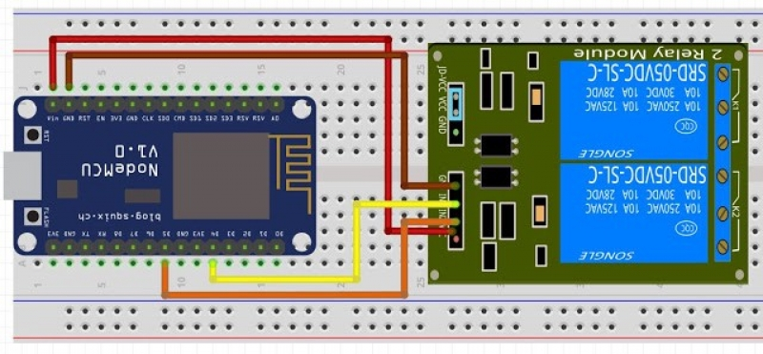
RELAY MODULE WITH NODEMCU

Slide 36
RELAY MODULE WITH NODEMCU
Introduction:
There are only four main parts in a relay:
Electromagnet
Movable Armature
Switch point contacts
Spring
An iron core is surrounded by a control coil. When current starts flowing through the control coil, the electromagnet starts energizing and thus intensifies the magnetic field. Thus the contact arm starts to be attracted to the fixed arm and thus closes the contacts causing a short circuit for the power to the load. On the other hand, if the relay was already de-energized when the contacts were closed, then the contact move oppositely and make an open circuit.
As soon as the coil current is off, the movable armature will be returned by a force back to its initial position. This force will be almost equal to half the strength of the magnetic force. This force is mainly provided by two factors, spring and gravity.

Slide 37
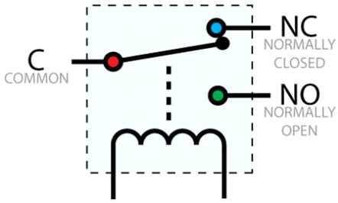
RELAY MODULE WITH NODEMCU

Slide 38
RELAY MODULE WITH NODEMCU
Components Needed:
NodeMCU
2-channel Relay Module
MicroUSB Cable
Breadboard/Jumper Wires
Connections:
GND and VCC pins of the Relay module are connected to GND and VU(or VIN) of the NodeMCU respectively.
IN1 and IN2 pins of the Relay module is connected to D4 and D5 pin of the NodeMCU respectively.
The other ground of the Relay Module should also be connected to a GND pin on the NodeMCU.
(It is recommended to do the connections after code uploading)

Slide 39
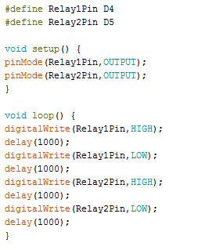
Relay module WITH NODEMCU
Upload the following code into the NodeMCU using Arduino IDE

Slide 40
Relay module WITH NODEMCU
Code Explanation:
Firstly pin D5 and D6 are defined as Relay1Pin and Relay2Pin which will energize the coil of 1st and 2nd Relay respectively.
Then, in the void setup() function, the pin modes of Relay1Pin and Relay2Pin is set to OUTPUT.
Finally, in the void loop () function, the Relay1Pin and Relay2Pin is set to HIGH and LOW on 1 second interval respectively.
Result:
After the code is uploaded and all the connections are done, the first and then the second relay will turn on and off at one second interval.

Slide 41
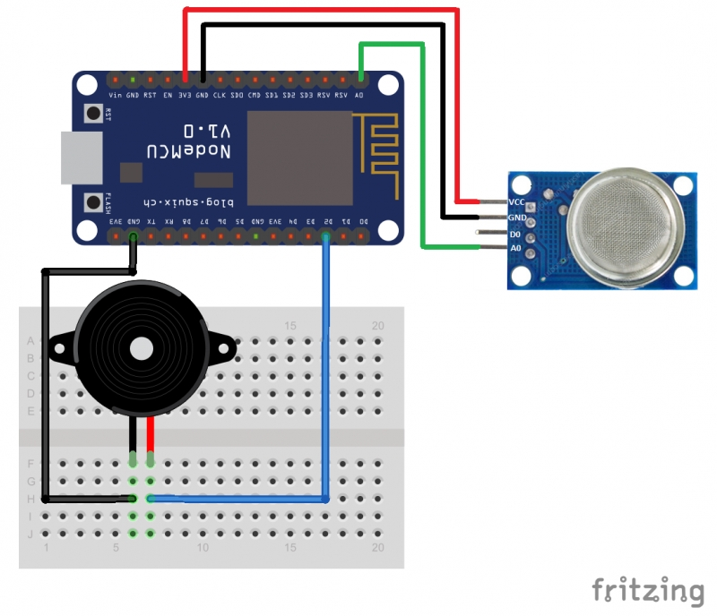
MQ-2 gas sensor WITH NODEMCU

Slide 42
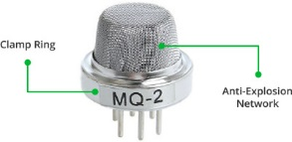
MQ-2 Gas SENSOR WITH NODEMCU
Introduction:
The Gas Sensor (MQ2) module is useful for gas leakage detection (home and industry). It is suitable for detecting H2, LPG, CH4, CO, Alcohol, Smoke or Propane. Due to its high sensitivity and fast response time, measurement can be taken as soon as possible. The sensitivity of the sensor can be adjusted by potentiometer. The sensor is actually enclosed in two layers of fine stainless steel mesh called Anti-explosion network. It ensures that heater element inside the sensor will not cause an explosion, as we are sensing flammable gases.

Slide 43
Mq-2 gas Sensor WITH NODEMCU
Components Needed:
NodeMCU
MQ-2 Gas Sensor
Piezo Buzzer
MicroUSB Cable
Breadboard/Jumper Wires
Connections:
VCC pin of MQ-2 is connected to 3V pin of NodeMCU.
GND pin of MQ-2 is connected to GND pin of NodeMCU.
A0 pin of MQ-2 is connected to A0 pin of NodeMCU.
Positive (+) pin of Buzzer is connected to D2 pin of NodeMCU.
GND (-)pin of Buzzer is connected to GND pin of NodeMCU.
(It is recommended to do the connections after code uploading)

Slide 44
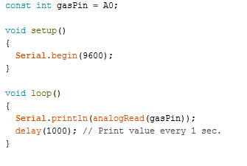
Mq-2 gas sensor WITH NODEMCU
Upload the following code into the NodeMCU using Arduino IDE

Slide 45
Mq-2 gas sensor WITH NODEMCU
Code Explanation:
Firstly, the pin D2 of the NodeMCU where the Positive (+) of the Buzzer is connected (called buzzer), and pin A0 of the NodeMCU where the A0 pin of the MQ-2 is connected (called smokeA0) are defined.
Then the value of sensor threshold “sensorThres” is defined. If the sensor’s output value (which is proportional to the amount of gas present around it) exceeds this value, the buzzer/alarm goes off. This must be set keeping in view the sensor’s output value in normal atmosphere.
Then in the <void setup()> the pin modes for the buzzer pin and the smokeA0 pin are set as output and input respectively. Besides this the serial communication between the PC and the NodeMCU is initialized at a baud rate of 9600 bits per second.
In the <void loop()> function, an integer variable analogSensor is defined in which the value analogously sensed from the MQ-2 (A0) will be saved. Then, this value is printed on the Serial monitor.
Afterwards there is an if statement which defines that the buzzer sets off if the analogSensor value read from the MQ-2 is greater than the threshold “sensorthres”.The tone function operating the buzzer takes two arguments: but can take three: First is the Pin number, second is the Frequency - this is in hertz (cycles per second) which determines the pitch of the noise made and third is the Duration - how long the tone plays.
Result:
After the code is uploaded and all the connections are done, the buzzer should make noise when a flammable gas (or a gas from the list) is detected.

Slide 46
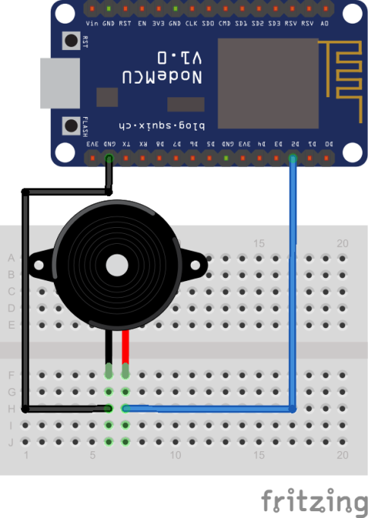
PIEZO BUZZER WITH NODEMCU

Slide 47
PIEZO BUZZER WITH NODEMCU
Introduction:
The piezo buzzer produces sound based on reverse of the piezoelectric effect. The generation of pressure variation or strain by the application of electric potential across a piezoelectric material is the underlying principle. These buzzers can be used alert a user of an event corresponding to a switching action, counter signal or sensor input. They are also used in alarm circuits.
The buzzer produces a same noisy sound irrespective of the voltage variation applied to it. It consists of piezo crystals between two conductors. When a potential is applied across these crystals, they push on one conductor and pull on the other. This, push and pull action, results in a sound wave. Most buzzers produce sound in the range of 2 to 4 kHz.

Slide 48
Piezo buzzer WITH NODEMCU
Components Needed:
NodeMCU
Piezo Buzzer
MicroUSB Cable
Breadboard/Jumper Wires
Connections:
Positive (+) pin of Buzzer is connected to D2 pin of NodeMCU.
GND (-)pin of Buzzer is connected to GND pin of NodeMCU.
(It is recommended to do the connections after code uploading)

Slide 49
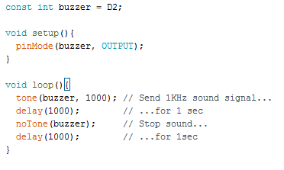
Piezo buzzer WITH NODEMCU
Upload the following code into the NodeMCU using Arduino IDE

Slide 50
PIEZO Buzzer WITH NODEMCU
Code Explanation:
Firstly, the pin D2 of the NodeMCU where the Positive (+) of the Buzzer is connected (called buzzer) is defined.
Then in the <void setup()> function, the pin mode for the buzzer pin set as output.
In the <void loop()> function, firstly the buzzer is given a square wave of 1000Hz (1kHz) using the tone function for one second and then it is kept silent using the notone function for one second.
The tone function operating the buzzer takes two arguments: but can take three: First is the Pin number, second is the Frequency - this is in hertz (cycles per second) which determines the pitch of the noise made and third is the Duration - how long the tone plays.
Result:
After the code is uploaded and all the connections are done, the buzzer should make noise for one second and should be silent for one second.

